Slide 1
ISIT 324 Software Testing
Testing Frameworks (1)

Slide 2
First things first...
Homework 1 – A source of consternation and conflict

Slide 3
On the Docket
Homework 2 Review
Discussion 2
Test Automation using MSTest

Slide 4
Homework 2 Review

Slide 5
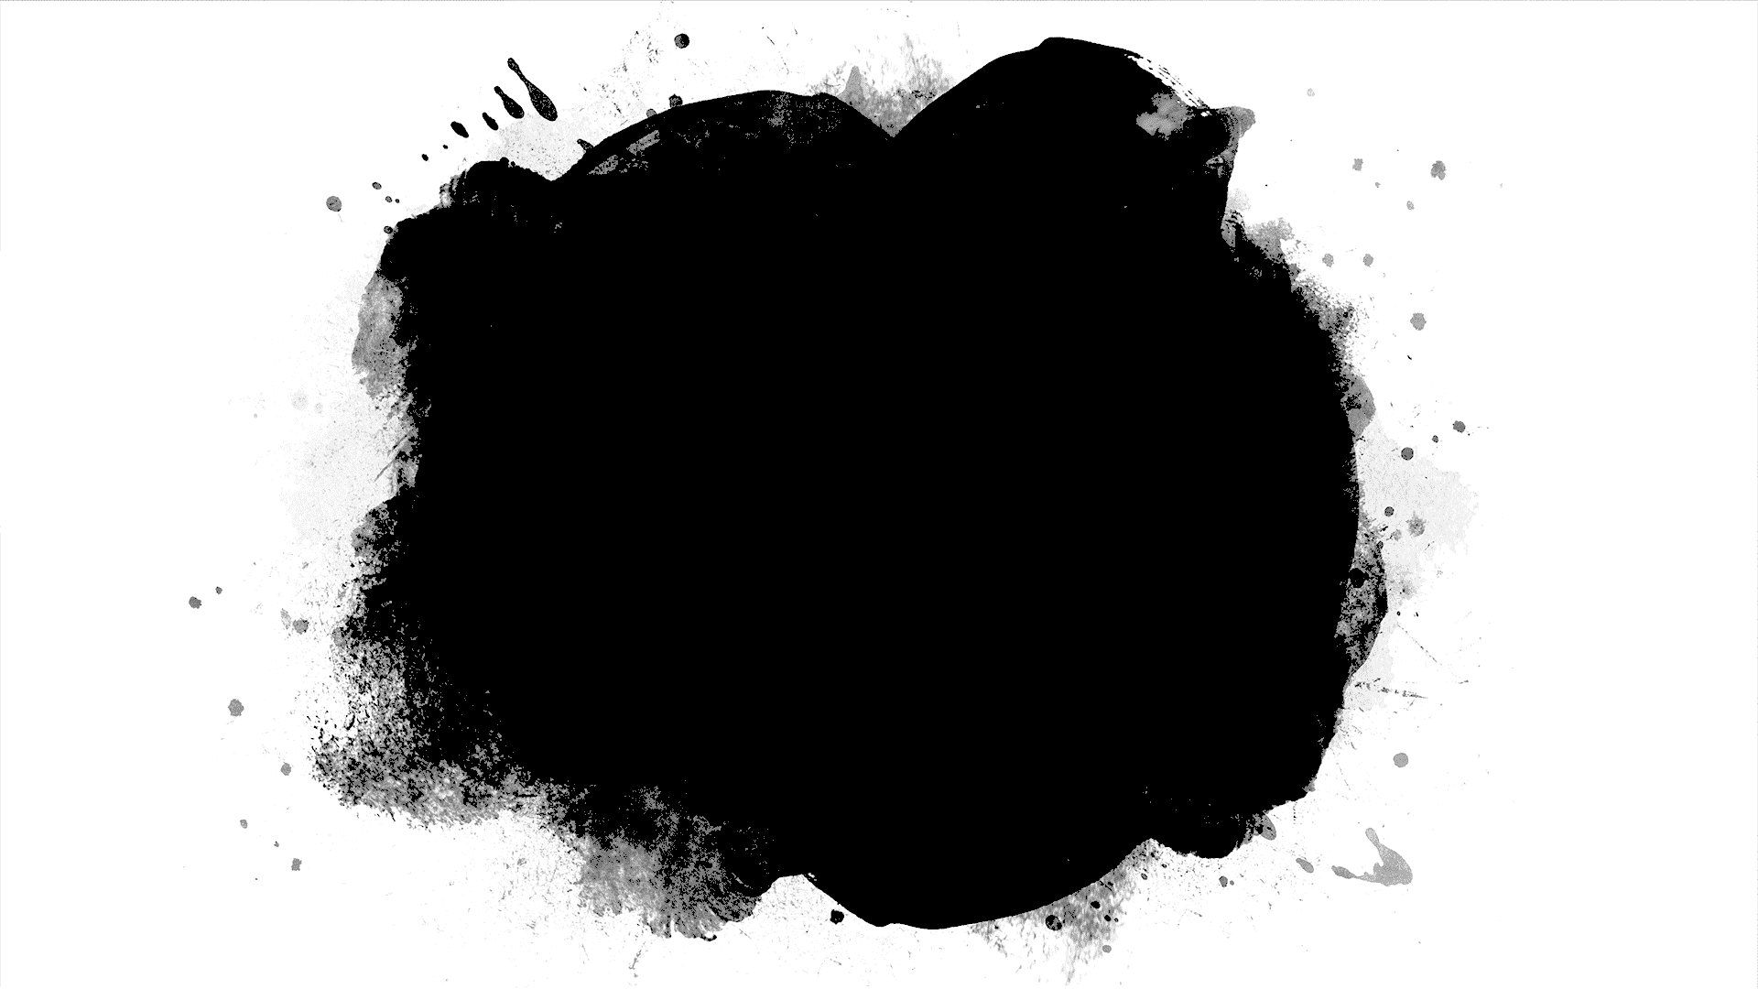
In-Class Discussion 2

Slide 6
Test Automation
Notes:
Note that Ammann and Offutt are very much computer science-focused with a strong emphasis on math. While this bias permeates the book, we’ll take the relevant parts and omit the rest.

Slide 7
What is Test Automation?
The use of software to control the execution of tests, the comparison of actual outcomes to predicted outcomes, the setting up of test preconditions, and other test control and test reporting functions
Reduces cost
Reduces human error
Reduces variance in test quality from different individuals
Significantly reduces the cost of regression testing
Regression testing is the process of testing code that has been modified

Slide 8
Software Testability
The degree to which a system or component facilitates the establishment of test criteria and the performance of tests to determine whether those criteria have been met
Plainly speaking – how hard it is to find faults in the software (remember RIPR)
Testability is dominated by two practical problems
How to provide the test values to the software
How to observe the results of test execution

Slide 9
Observability and Controllability
Observability
Software that affects hardware devices, databases, or remote files have low observability
Controllability
Easy to control software with inputs from keyboards
Inputs from hardware sensors or distributed software (including Web applications)is harder
Data abstraction reduces controllability and observability
How easy it is to observe the behavior of a program in terms of its outputs, effects on the environment and other hardware and software components?
How easy it is to provide a program with the needed inputs, in terms of values, operations, and behaviors?

Slide 10
Components of a Test Case
A test case is a multipart artifact with a definite structure
Test case values
Expected results
A test oracle uses expected results to decide whether a test passed or failed
The input values needed to complete an execution of the software under test
The result that will be produced by the test if the software behaves as expected

Slide 11
FindLast Refresher

Slide 12
Test Automation Framework
A set of assumptions, concepts, and tools that support test automation
Popular frameworks for .Net
MSTest v2 (built into VS 2017)
NUnit
xUnit
Comparison: http://xunit.github.io/docs/comparisons.html
Note: this doc shows MSTest v1.5. MSTest v2 is better.
Current consensus:
MSTest is better integrated into VS than the others (although the others are still pretty nicely integrated), but
xUnit is the next stage in unit testing evolution and is most full-bodied
JUnit for Java aficionados

Slide 13
MSTest, xUnit, NUnit, JUnit, et al, can be used to test:
An entire object,
A part of an object – a method or some interacting methods, or
Interaction between objects
Good for unit and integration testing, but not so much for system testing

Slide 14
Components of the Testing Environment
Software Under Test (SUT)
Test Class
Test Runner

Slide 15
MSTest Special Sauce
MSTest v2 pre-integrated into VS starting in 2017
Create a UnitTest project and you get:
References to the Testing assemblies
A shell that includes unit test .Net attributes, and
A handy using statement for the UnitTesting namespace
[TestClass] tells VS that the following class holds unit tests
[TestMethod] tells VS that the following method is a unit test
Assert is a method that the Test Runner can use to determine whether a method passed or failed.

Slide 16
Arrange, Act, Assert
General convention for constructing a test (using TDD, discussed in an upcoming lecture)
Arrange: Get everything ready to call the method. Initialize classes, variables, etc.
Act: Call the method.
Assert: Check to see whether the method returned the expected result

Slide 17
Method Naming Conventions
FindLast test where:
x = {1, 2, 5}, and
y = 1
Lots of Alternatives
FindLastTest1
TestReturnIndexOfFirstElement
FindLast_LastInstanceIsFirstElement_ReturnsZero
FindLast_Should ReturnZero_WhenLastInstanceIsFirstElement

Slide 18
In this class:
Put all tests of a method in the same class named <method>_Should
Each test is a TestMethod and is named <expected behavior>_When<state being tested>
Examples:
TestClass public class FahrenheitToCelsius_Should
TestMethod ReturnZero_WhenInputIs32
TestMethod Return100_WhenInputIs212
TestMethod ThrowException_WhenInputIsMinus1000

Slide 19
Make FindLast Tests Proper Unit Tests

Slide 20
Unit Test initial setup
Add a Unit Test project to the solution
Right click the solution name
Select Add -> New Project
In the left nav bar, select Test
Select Unit Test Project (.NET Framework)
For grins, look at the References in the Unit Test project
Note: that reference to System is what allows you to use the programs in the System namespace

Slide 21
Unit Test initial setup (continued)
Add NuGet packages to supply assemblies to support Unit Testing and the Test Explorer (no longer usually required)
Right-click the Unit Test project you added
Select Manage NuGet packages
Select the Browse tab.
Search for MSTest
Select MSTest.TestFramework and select Install, accept the license, etc.
Select MSTest.TestAdapter and select Install, accept the license, etc.
Now look at references again. See the new stuff?

Slide 22
Unit Test initial setup (continued)
Add a reference from the Unit Test project to the project under test
Solution Explorer: Right-click References in the Unit Test project
Select Add Reference to start the Reference Manager
Choose Projects -> Solution in the Reference Manager navigation window
Select your ClassLibrary project and click OK.
Look at the references in Solution Explorer and you’ll see the reference added.
Add a using statement to alias the Class Library namespace to the name SUT (for Software Under Test).

Slide 23
Useful patterns…
Make it easy to identify software under test:
Check to see if an exception is properly thrown:
Class name and method name are readable:
Organize your tests using Arrange, Act, Assert
using SUT = FindLast30.SearchArray;
Assert.ThrowsException<NullReferenceException>(() => SUT.FindLast(x, y));
public class FindLast_Should
public void ReturnMinus1_ForSearchValueNotInArray()

Slide 24
The Tests (based on Manual Test Harness)
FindLast_Should…
ReturnNegative1_WhenInputNotInArray
Return1_WhenInputInSecondPosition
Return0_WhenInputInFirstPosition
ThrowNullReferenceException_WhenArrayIsNull

Slide 25
Consolidate Common Tests Using Parameterization
New in MSTest v2
Fibonacci

Slide 26
Parameterized Tests
Provides a way to iteratively inject expected and actual values into the same test method. Test runs repeatedly until value sets are exhausted.
MSTest V2, NUnit and xUnit all support parameterization of tests.
NUnit and xUnit use the terms “Fact” to describe non-parameterized tests and “Theory” for parameterized ones.
MSTest uses “DataTestMethod.” Doesn’t sound quite as grand, but it’s about the same thing.

Slide 27
Parameterizing in MSTestV2
[DataTestMethod] attribute identifies parameterized test method
[DataRow(values)] attributes for each test execution
Values: comma-separated list of values to be fed to the test method parameters
By convention, the last value is the “expected” value
Test method
One parameter per list of values in DataRow attributes
Executes once per data row
Each time substitutes one set of DataRow values for parameters

Slide 28
FindLast with Parameterized Tests

Slide 29
Introducing Homework 3

